Slide 2


-
-
-
-
-

Slide 3



Slide 4







Slide 5





A is a text document that contains all the commands a user could call on the command line to assemble an image.

Slide 6







Slide 7


Slide 8




FROM LABEL ENV WORKDIR COPY RUN EXPOSE
node:alpine author="John Doe" NODE_ENV=production
/var/www
. .
npm install 3000
ENTRYPOINT ["node", "server.js"]

Slide 10


Slide 11






-t <name> .
docker build

Slide 12
docker build -t nodeapp .

Slide 13







Slide 14


-t <registry>/<name>:<tag> .
docker
build

Slide 15
docker build -t johndoe/nodeapp:1.0 .

Slide 16


docker images
docker rmi <imageId>

Slide 19

<user name>/<image name>:<tag>
docker
push

Slide 21
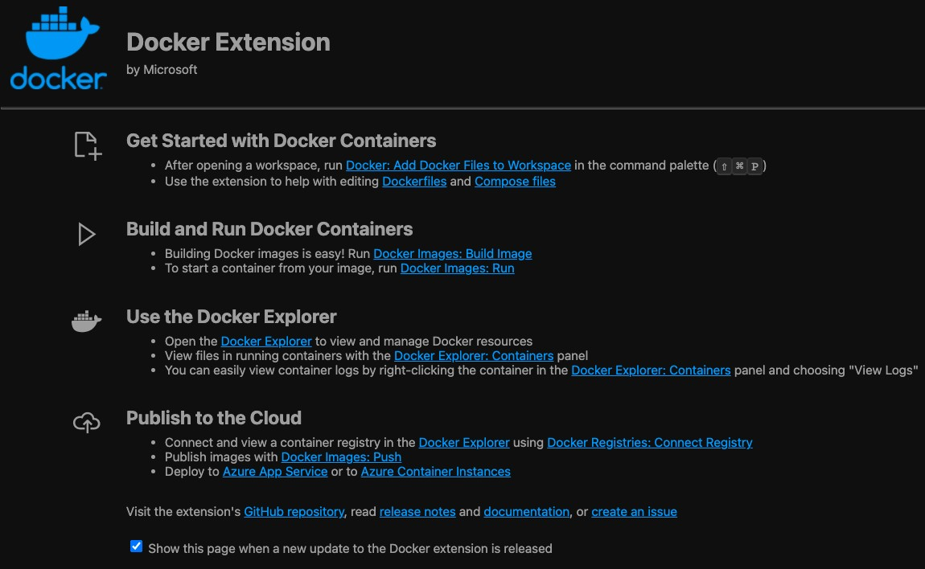

Slide 22






-
-
-
-
-

